Slide 1
Distributed Control and Automation Framework (DCAF)
DCAF Debugging

Slide 2
Agenda
Basics RT Debugging
Debugging Reentrant Vis.
Running modules outside of the Engine.
Syslog
Tag View
CVT

Slide 3
Basics RT Debugging

Slide 4
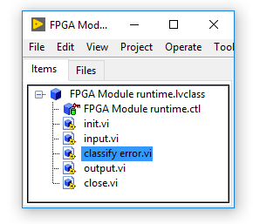
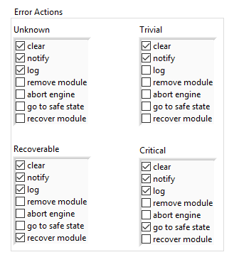
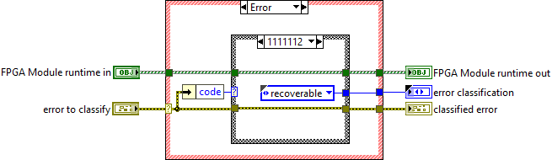
Error Management

Slide 5
Debugging Reentrant VIs

Slide 6
Running Modules Outside of the Engine

Slide 7
Syslog

Slide 8

Syslog
Available in Linux RT Targets
Event sent to Log:
Initialization and shutdown of all software modules
Any error reported to the engine
Any module trace messages added via the API

Slide 9
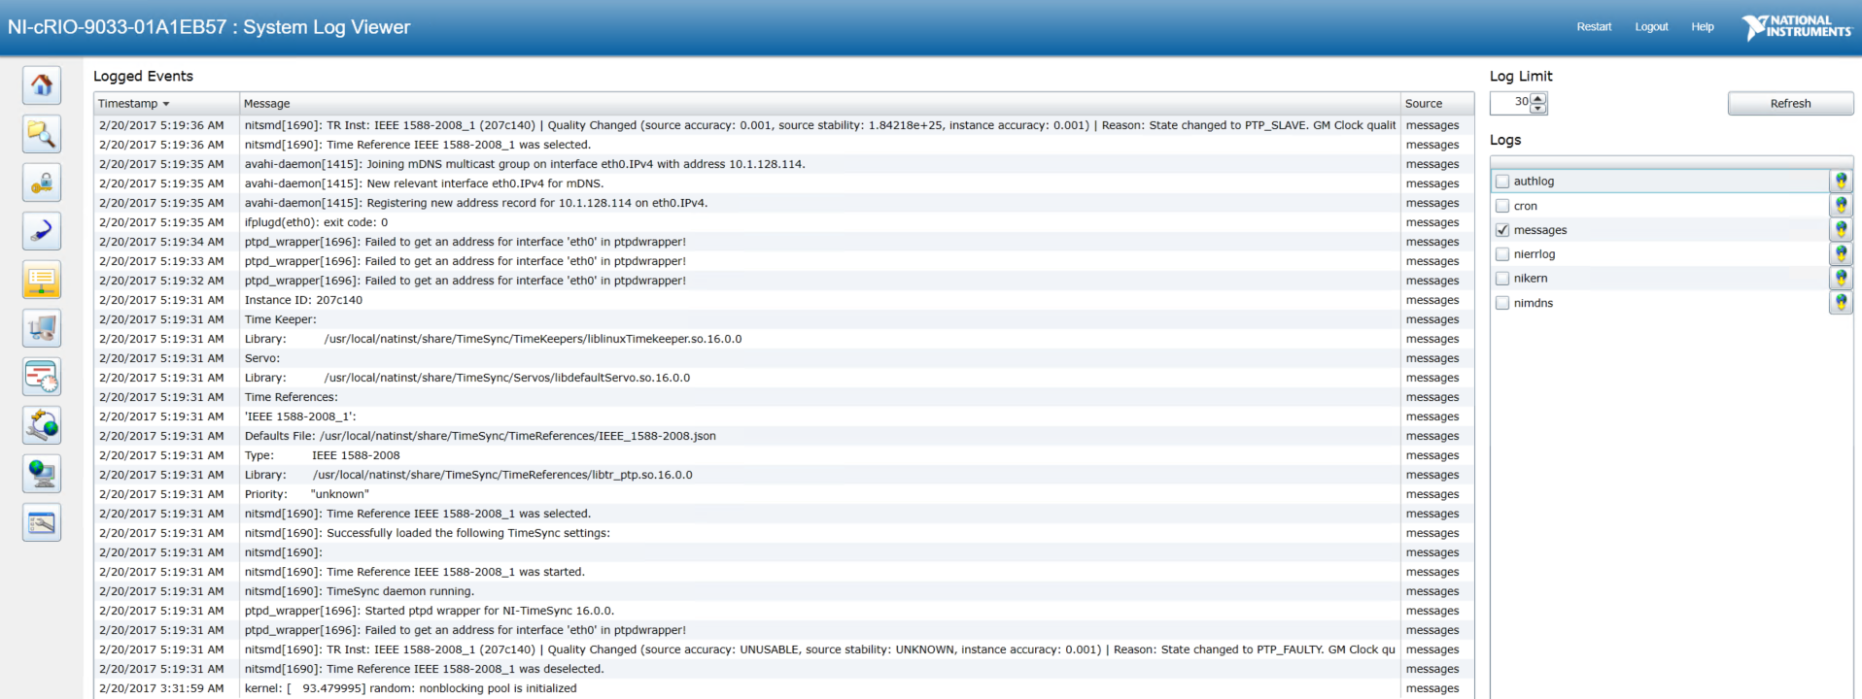
Syslog - System Log View

Slide 10
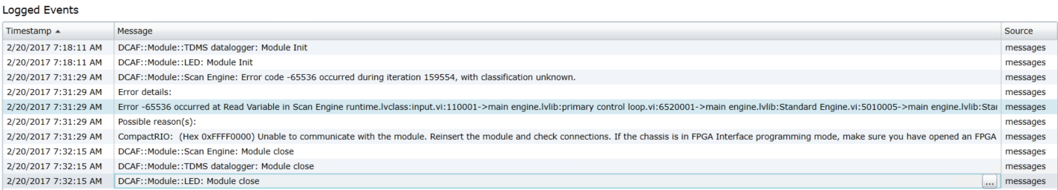
Syslog - System Log View

Slide 11
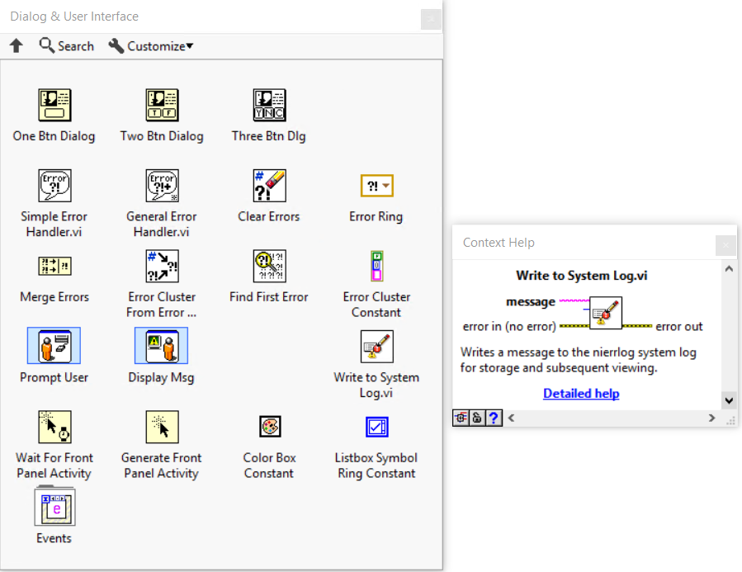
Syslog
NI Linux RT targets already have a syslog-ng daemon running
DCAF taps into the existing background process to log and report messages
You can, too!
Notes:
Add WIF

Slide 12
Tag View

Slide 13
CVT

